Slide 1
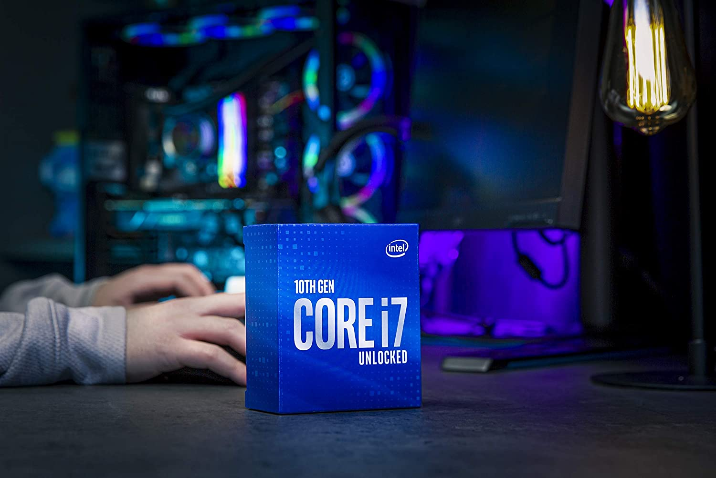
WELCOME TO OUR PRESENTATION

Slide 2
Research Topic
10th Gen Intel Core i7 10700k

Slide 3
Group Members:
Sabrina Oyshe – UG02-44-17-002
Ashraf Uddin Mamun – UG02-44-17-044
Sanjida Akhter – UG02-47-18-006

Slide 4
Topics Of Discussion:
ADVANTAGE:
DISADVANTAGE:
WHY THIS PAPER IS UNIQUE:
EXPERIMENTAL RESULT SECTION EXPLANATION:
FEATURES:
PROBLEM STATEMENT:
MOTIVATION OF OUR RESEARCH:
PROPOSED METHODOLOGY:
EVALUATION OF EFFECTIVENESS:
IMPORTANCE OF OUR RESEARCH:
SCOPE AND LIMITATION:

Slide 5
Basic Info:
Intel has placed the Core i7-10700K right behind the Core i9-10900K, which means this processor should be able to hold its own against its sibling, as well as AMD's Ryzen 7 3800X and Ryzen 9 3900X.
AMD rocked the boat with high-end Ryzen and Thread ripper processors, so Intel hopes the Core i7-10700K can tempt customers with solid mid-tier performance.

Slide 6
Advantage:
Intel’s 10Th Generation Core CPU’s offer all sorts of upgrade benefits, no matter what kinds of tasks you perform. They offer more threads, higher clocks, improved power efficiency and amazing gaming performance.
The Good:
Eight cores and 16 threads
Unlocked multiplier
Amazing gaming performance
Great at both single- and multi-core workloads
High clock and boost frequencies

Slide 7
Disadvantage:
Unfortunately, there’s no Thermal Velocity Boost, which is a fancy name for the algorithm that can push the CPU even further by running all cores at beyond Turbo Boost speeds in short bursts.
The Bad:
$410 is not a competitive price
Consumes more power at 125W
Outdated manufacturing process for thermals
No bundled cooler
PCIe 3.0 interface
Incompatible with older motherboards

Slide 8
WHY THIS PAPER IS UNIQUE:
The Intel Core i7-10700K, like most modern processors, is extremely good.
Gone are the days where you’d need to go with the highest-grade CPU to get the most out of your PC.
Even a Core i3 or Core i5 will allow you to get plenty done.
The Core i7-10700K is a serious processor for serious workloads.

Slide 9
EXPERIMENTAL RESULT SECTION EXPLANATION:
Intel 10th Gen Core i7-10700K Processor Introducing the all-new 10th Generation Intel Core i7 10700K processor, Unlocked 10th Gen Intel Core desktop processors are optimized for enthusiast gamers, overlockers, and serious content creators looking to take advantage of amazing overclocking and unleash the performance capabilities of these new processors.

Slide 10
Main Features :
Brand : Intel
Model : Intel Core i7-10700K
Base Frequency : 3.80 GHz
Max Turbo Frequency : 5.10 GHz
Cache Memory : 16MB Smart Cache
Number of Cores : 8
Threads : 16
Bus Speed : 8 GT/s
TDP : 125 W
Configurable TDP-down Frequency : 3.50 GHz

Slide 11
PROBLEM STATEMENT:
The 10Th Generation chip is not for all users in spite of its high speed. This is not much to support all tasks. The speed of encoding entirely depends on the software used and its compatibility.

Slide 12
MOTIVATION OF OUR RESEARCH:
Our aim is to represent an advance and upgrade processor.
It is useful as its objectives are best CPU around for gaming, excellent single and multi-core performances.
The purpose of research is to discover answers to questions through the application of scientific procedures.
The main aim of research is to find out the truth which is hidden and which has not been discovered as yet.

Slide 13
PROPOSED METHODOLOGY:
The Intel Core i7-10700K is a desktop processor with 8 cores, launched in April 2020.
It is part of the Core i7 line-up, using the Comet Lake architecture with Socket 1200.
Intel is building the Core i7-10700K on a 14 nm production process, the transistor count is unknown.
You may freely adjust the unlocked multiplier on Core i7-10700K, which simplifies overclocking greatly, as you can easily dial in any overclocking frequency.

Slide 14
EVALUATION OF EFFECTIVENESS:
If we evaluate and compare with core i9–10900k.
It’s similar to that but comes at a lower price point and has two fewer cores.
What’s interesting, however this is best gaming CPU.
It is a powerful mid-tier desktop processor rocking eight cores and 16 threads.

Slide 15
IMPORTANCE OF OUR RESEARCH:
Research unlocks the unknowns, lets you explore the world from different perspectives.
Here are some reasons why our research is important:
Research expands your knowledge base
Research gives you the latest information
Research helps you know what you’re up against
Research introduces you to new ideas
Research helps with problem-solving
Research helps you reach people
Research encourages curiosity

Slide 16
SCOPE AND LIMITATION:
As we know there are a good number of scope of our research topic. It has so much advance technology like it is:
Intel optane memory supported.
It has turbo boost technology,
also it has Intel vpro platform eligibility.
Though it’s limitations are few:
It has no thermal velocity boost.
No transnational synchronizal extension.
No bundled cooler &
Incompatible with older motherboards

Slide 17
Conclusion:
Overall, the Core i7-10700K gives you nearly the same gaming performance as the Core i9-10900K, but for $110 less, and overclocking eliminates any meaningful difference in gaming performance between the chips. You also get extremely competitive single-threaded performance at stock settings.

Slide 18
Thanks Everyone
For Hearing Us

